Slide 1
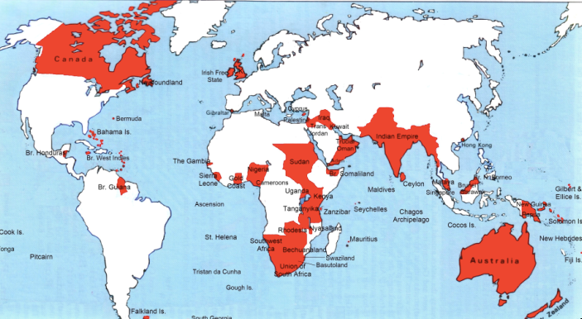

Lecture: 3.3.2. The Scramble
0:15 of audio in this slide; 18:45 in this slide group
Notes:
Let’s look at a few small pieces of the scramble that turned the entire world—except for China (sorta) & Tibet, Japan, Thailand, & Ethiopia—into either European-ruled or European settler-ruled territory by 1914.

Slide 2
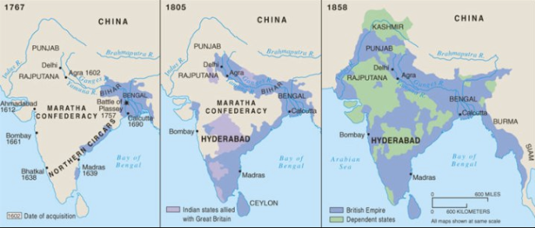
The Conquest of India
1767: Bombay, Madras, Calcutta, and tax collector for the collapsing Mogul Empire in Bengal and Oudh
1805: armies composed 3/4 of soldiers born in India; Viceroy Richard Wellesley’s conquest policy
1858: conquest complete with suppression of Sipahi Uprising
2:30 of audio in this slide
Notes:
In early 1756 the newly-installed Nawab of Bengal, Mîrza Mohammad Siraj ud-Dowla, wished to show the British in Calcutta who was master of Bengal. He borrowed some gunners and artillery pieces from the French and attacked and captured Calcutta and its Ft. St. William. He expected negotiations, and that the subsequent peace would see gratitude toward him on behalf of the French, much higher taxes paid him by trading Europeans, and much less tax evasion via smuggling by British who understood their place.
Big mistake.
The British sent 3,000 soldiers—800 British, 2200 Indian—north by sea from Madras to Calcutta. Siraj ud-Dowla mobilized for the battle. British commander Robert Clive bribed the Nawab’s three subordinates. The British East India Company acquired the taste for conquering, ruling, and taxing India, rather than merely trading with it.
By 1765 the British East India Company had successfully petitioned the Moghul Emperor in Delhi to be his tax collector for Bengal and Bihar.
By 1772 Calcutta was the capital of British India. Warren Hastings was its first Governor-General. The British East India Company had entered the sweepstakes in the succession wars over the territories of the Mogul empire.
The conquests which British-trained Indian-recruited armies that made the British the dominant power in India in the eighteenth century were carried out on a shoestring. Yet they soon became mopping-up operations: small wars against Indian powers that had no chance of assembling the resources to match the British-controlled forces in India. Each generation saw formerly independent principalities become subservient allies. Each generation saw former allies become puppets. And each generation saw former puppets become territories ruled by London. Nearly a century after Clive and Siraj ud-Dowla came the great the 1857 Sepoy Mutiny/Indian Mutiny/Sipahi Rebellion/Great Rebellion of 1857. It was defeated. And on May 1, 1876, the British government proclaimed Queen Victoria I Hanover to be Kaiser-i-Hind: Empress of India.

Slide 3
Karl Marx’s Take
Karl Marx wrote about India back in 1853
He was a penniless exile in England, then, and he had to make money
So he wrote articles for the New York Herald Tribune
He saw England as having a double mission in India
Destroy “feudalism”
Bring “capitalism”
Bloody, destructive, deadly
But out of evil good would come, perhaps in half a century or less
He was wrong
2:45 of audio in this slide
Notes:
Karl Marx back in 1853 had taken a look at the Future Results of British Rule in India. He then prophesied that the British imperial conquest of India was India’s greatest short-run curse and would be its greatest long-run blessing:
>England has to fulfill a double mission in India: one destructive, the other… laying the material foundations of Western society in Asia.... The political unity of India... imposed by the British sword, will now be strengthened and perpetuated by the electric telegraph. The native army, organized and trained by the British drill-sergeant, [will be] the sine qua non of Indian self-emancipation.... The free press... private property in land… Indian natives, reluctantly and sparingly educated... a fresh class....
>The millocracy… intend now drawing a net of railroads over India… with the exclusive view of extracting… [will] lay down the material premises.…
>Has the bourgeoisie ever done more? Has it ever effected a progress without dragging individuals and people through blood and dirt, through misery and degradation?...
Yet as of 1913 the great economic and social changes that Karl Marx had confidently predicted sixty years before had not advanced far.
The drawing of a net of railways over India? Check. The introduction to India of those industries necessary to support the railroads? Check. The spread of other branches of modern industry across India? Not so much. The spread of modern education across India? Not so much. Improvements in agricultural productivity resulting from the creation of effective private property in land? Not at all. Overthrow of the caste system? Not at all.
The overthrow of British colonialism, the restoration of self-government, and the creation of subcontinental political unity by virtue of a revolt by the British-trained army? They had come close, but only close, in 1857.
The failure of the British Raj to transform India or perhaps to transform India faster poses an enormous problem for all of us economists. We are all, even the Marxists (back when there were Marxist economists), the intellectual children of the Adam Smith who wrote:
>Little else is requisite to carry a state to the highest degree of opulence from the lowest barbarism, but peace, easy taxes, and a tolerable administration of justice: all the rest being brought about by the natural course of things...
Under the British Raj in the late nineteenth and early twentieth centuries India had a remarkable degree of internal and external peace, a tolerable administration of justice, and easy taxes. Yet no sign of progress “to the highest degree of opulence” had occurred.

Slide 4
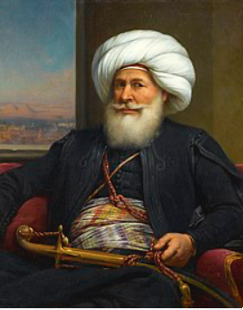
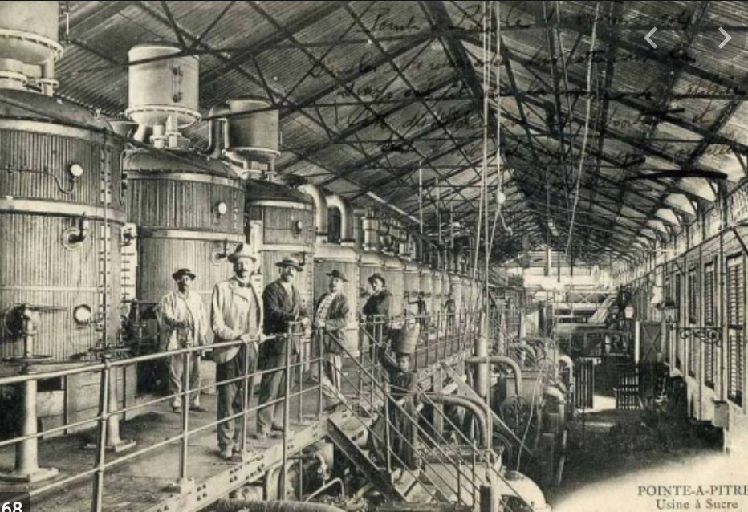
Egypt
Albanian Orphan Muhammed Ali (1769-1849):
Became effectively independent ruler of Egypt
(Still had prayers said in the mosques for the Ottoman Turkish sultan in Constantinople)
Strove to make Egypt great again
Cotton
Cotton textile factories
Sugar factories
Saw what was coming down
Feared that if Egypt did not industrialize, his grandchildren would be puppets of French bankers and British generals
Guess what?
3:45 of audio in this slide
Notes:
Muhammed Ali (1769-1849), an Albanian orphan, son of a shipping merchant Ibrahim Agha and his wife Zeynep, was bored being a tax collector in the Ottoman-ruled Greek port of Kavala. In 1801 he enlisted as a mercenary in the Ottoman army sent to occupy Egypt. By 1803 he commanded a regiment of his ethnically Albanian fellow-countrymen.
The Ottoman governor of Egypt could not afford to pay. He dismissed his Albanian troops. They mutinied, took over the government, and collected their pay. But Albanian commander Tahir Pasha then had no money to pay the Turkish janissaries.
Somehow Muhammed Ali wound up on top.
He retained the loyalty of his Albanians and managing to suppress both Turkish janissaries and Egyptain Mamluks. He then received at least the temporary blessing of Ottoman Sultan Selim III the Reformer (before he was deposed, imprisoned, and murdered by his own janissaries).
Muhammed Ali looked northwest at Europe and east to India. He noted Egypt’s role as crossroads between Africa and Asia, and between the Atlantic-Mediterranean Sea and the Red Sea-Indian Ocean. He ruled a prosperous kingdom—but he saw that Europeans might do to his or his children’s kingdom what Europeans had done to prosperous kingdoms in India.
So Muhammed Ali strove to make Egypt great: new crops, land reform, a modern military, a focus on cotton as an export, and the construction of state-owned textile factories to jump-start Egyptian industry. He understood that unless he could keep the machines working, his great-grandchildren would become the puppets of French bankers and British proconsuls.
But in Egypt in the first half of the 1800s, the machines could not be kept working.
In 1863, six years before the completion of the Suez Canal, the relatively young Khedive Ismail took the throne of Egypt.
Ismail had been educated in France: he was open to European influences, eager to modernize his country, and eager to play the role of the open-handed Eastern ruler. He became ruler of Egypt in 1863, in the middle of the "cotton famine" created by the American Civil War and the consequent temporary disappearance of the U.S. South from the world's cotton supply. The consequence was a cotton boom everywhere else in the world: the factories of the industrial revolution needed cotton to run on, and they were willing to pay almost any price for it. Egypt grew cotton. And so for a few years it seemed as though Egypt's economic resources and wealth were growing rapidly and were inexhaustible.
In 1876 the Egyptian government declared bankruptcy. The creditors of the Khedive became the rulers of the country. Ismail abdicated. Two financial controllers—one British, one French—were appointed with substantial control over taxes and expenditures. Their task was to make sure that Egypt was governed by Ismail's son to keep up revenue and pay off the debt. The Egyptians wondered why they were being highly-taxed to pay off debts run up by their extravagant ex-Khedive. British troops restored order in 1882. Thereafter the Khedive was a British puppet: the strategic importance of the Suez Canal for communications with India meant that British troops were to stay in Egypt on varying pretexts and for various reasons until 1956.
Muhammed Ali’s great-grandchildren were indeed the puppets of French bankers and British proconsuls

Slide 5
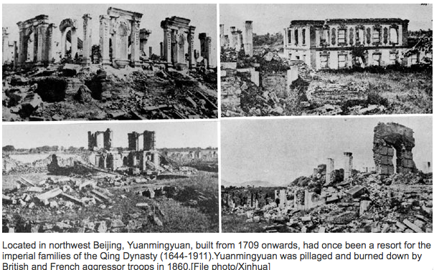
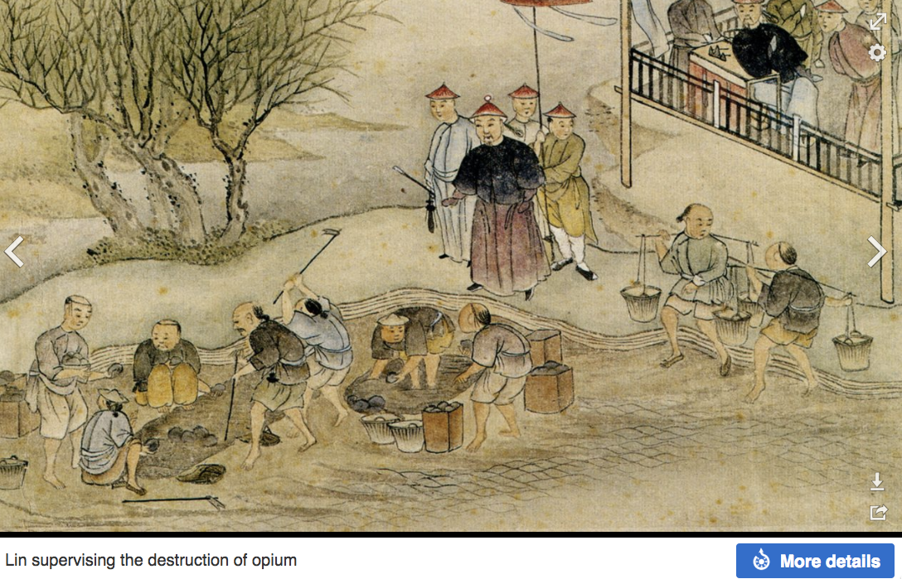
China
The puzzle of China vs. Japan
Great Qing (大清)(1644-1912)
Wu Sangui (吳三桂)
The Rebellion of the Three Feudatories (三藩之亂)
Kangxi and Qianlong: “revere the emperor and expel the barbarians” is difficult to pursue when the emperor and his clan identify themselves as “barbarians”
Tai-Ping Rebellion (太平天國運動)
Cixi ( 慈禧太后)
2:30 of audio in this slide
Notes:
Japan began, even before 1870, to strengthen itself and industrialize its economy. China did not. The century 1870-1975 marks China’s relative nadir in world history.
Why?
One factor: The ethnically Manchu Qing Dynasty could not rally the country behind a slogan like “revere the emperor and resist the foreign barbarians” because the emperor and his relatives identified themselves as foreigners. Moreover, they were regarded by the Han elite as barbarians.
Over more than two centuries of rule the Qing government of China had trained its Confucian landlord-bureaucrat-scholar aristocracy to be incapable of taking effective action. Effective action might be directed against the Central Government Security Perimeter (which is, perhaps, how we ought to translate what was back then translated as “Forbidden City”).
Many western China specialists see and can almost touch an alternative history—one in which late-nineteenth century China stood up economically, politically, and organizationally. Japan, after all, won its short victorious war against Russia in 1905, negotiated as an equal with Britain and the U.S. over warship construction in 1921, was perhaps the eighth industrial power in the world by 1929, and in 1942 Japan’s six fleet-carrier striking force, kido butai, was the most powerful, most feared, most technologically advanced, and most deadly military force on the world’s oceans.
We economists are much more skeptical. We note that while things like the Qing Imperial Maritime Customs Service built up in the 1860s under Robert Hart, Hart allowed no Chinese officials in it, primarily because he feared he would be unable to control their corruption, given the powerful protectors in the Qing imperial court such officials would acquire. We note the corrupt and incompetent bureaucracies that failed to manage the Yellow River dikes and the Grand Canal. We note that the Qing could not get their local officials to collect the salt tax. We note that when in the mid-1880s the Qing Dynasty, having bought foreign metal-working machinery and built a navy, arsenals, and docks, thought it was strong enough to oppose the French conquest of Vietnam, its fleet was destroyed in an hour: the Chinese navy lost 572 dead, while the French lost five. In 1895 the Qing Dynasty thought it was strong enough to oppose the Japanese extension of their sphere of influence to Korea. It was wrong. The Treaty of Shimonoseki added Taiwan, Korea, and southern Manchuria to Japan's sphere of influence.

Slide 6
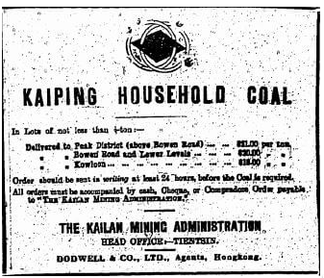
The Kaiping Coal Mine
Li Hongzhang (李鴻章) and the Kai-Ping coal mine…
From 1881…
Build up an industrial base…
Opposition…
Chang Yen-Mao
Bannerman
“Boxers” (义和拳)
Herbert Hoover
Chang Yen-Mao vs. Moreing…
Li Hongzhang (李鴻章) “did not have the reputation for financial disinterest enjoyed by his patron Zeng Guofan (曾国藩)”
3:00 of audio in this slide
Notes:
Why did not China have a chance of standing up in the later 1800s?
Let’s go back to the Kaiping coal mine, that we saw before as the source of Herbert Hoover’s first fortune.
Li Hongzhang was the bureaucratic prime mover behind that and such other “self-strengthening efforts” as the 1878 cotton mills in Shanghai, the Tianjin arsenal, the telegraph between Tianjin and Peking, and more. Individual governors-general like Li Hongzhang who made economic development a top priority could make some things happen—elsewhere things did not happen, outside of the foreign concessions and treaty ports like Qingdao, Tientsin, Shanghai, Guangdong, and Hong Kong.
In 1877 he commissioned experienced, wealthy, Hong Kong treaty-port comprador-merchant Tang Tingshu to build a modern, industrial, large-scale coal mine in Kaiping. They faced unusual forms of opposition. A British telegraph cable of 1882 stating that mining work had been stopped because Chi Shihchang, a vice-president of the Board of Civil Offices, had declared that:
>mining methods angered the earth dragon... [and so] the late empress could not rest quietly in her grave…
Li Hongzhang was this given the choice between abandoning his project for a modern coal mine to fuel steam engines, or accepting blame for any death or disease that might strike the imperial family. Given the size of the imperial family and mortality in the late nineteenth century, it would be a brave bureaucrat indeed who certified that there was no geomantic danger to the grave of the late empress from the earth dragon.
Li Hongzhang was brave.
Production began in 1881. By 1889, 3000 workers in three shifts were producing 700 tons of coal a day, using steam lifts, underground coal cars on rails, and pneumatic drills. By 1900, 9000 workers were producing 2000 tons a coal a day, with average pay 6 per month and with at least some Chinese-born technical employees making 60. The miners were producing 1/4 of what was expected of miners in America or Australia.
But the rate of production was still only six pounds a year for every person in China. And there was still no railway to Tientsin. In 1888 a railway had been built down to Taku, but Chief Engineer Claude Kinder reported: “high officials who detested the railway... foster[ed] trouble with the junk people.... So great was the clamor... that the Viceroy... gave the order for the nearly completed bridge [over the Peiho River to Tientsin] to be destroyed, although hundreds of the largest junks had already safely passed through…”
Then Herbert Hoover came.

Slide 7
Failure of “Self-Strengthening”
Kaiping: what had been a strategic initiative of the Chinese government becomes a western-owned corporation uninterested in training Chinese engineers…
But even before: the promotion of Chang Yenmao—a political fixer—meant that, unlike in Japan, economic strengthening was not job #1
Sun Yatsen offered his services to Li Hongzhang in 1894
Li sent him away
Yuan Shihkai came to the conclusion that working with the Manchu court was useless
China descended into revolution and anarchy…
2:00 of audio in this slide
Notes:
The upshot was that what Li Hongzhang and his successor in the Qing government Yuan Shihkai had thought was a strategic imperial government enterprise was now the property of a British-Belgian investors’ syndicate, with no interest in building China’s engineering capacity or supporting its foreign policy strategy.
A social-economic structure that could not find and promote executives but instead replaced them with corrupt political fixers, a political-ritual culture that required that a modernizing governor focus his attention constantly on the enterprise and run interference to protect it from anti-modernizers, and an educational system that continued to turn out literati instead of engineers—and thus required foreign technical personnel for everything—outside the charmed circles created by the extraterritorial foreign concessions, and to a slight degree the immediate span of control of the few modernizing governors, modern industries did not develop and modern technologies were simply not applied in late imperial China.
Visionary reforming politician Sun Yatsen had offered his services to Li Hongzhang in 1894, but Li sent him away. Sun Yatsen built up a financial and propaganda network among Chinese emigrants beyond the reach of the government.
Military politicians like Yuan Shihkai came to the conclusion that working with the Manchu court was useless.
At the beginning of 1912 Sun Yatsen launched his rebellion, and the Qing dynasty fell. Yuan Shihkai and his peers refused to suppress the rebellion, and thought their chances would be better without the Manchu Dynasty.
The six-year-old emperor abdicated. The new Chinese republic’s president turned out to be not Sun Yatsen military politician Yuan Shihkai. But Yuan Shihkai’s authority over his peers and near peers—army commanders, provincial governors, and other would-be warlords—was nil.
China descended into near-anarchy

Slide 8
We Could Tell More Stories
2:00 of audio in this slide
Notes:
We could tell many, many, many more stories of Europe’s late-1800s empires and how the colonized and the nearly-colonized tried to respond. But we have no space. So leave it there, with three: One was formally annexed, with Queen Victory of the Hanoverian Dynasty taking the title Kaiser-i-Hind—“Caesar of India”. (A title laid down only in 1947, to my knowledge the last time in history a ruler has called him or herself a “Caesar”. The historical shadow of the Divine Julius was indeed long.) One was informally annexed, with a strong British garrison. And one was always under the hammer of European and Japanese threat.
In all three the coming of imperialism and the market it brought Terry with a very cheap manufactured goods that the colonized could buy. And it carried with it infrastructure so that colonial proconsuls could communicate and travel back-and-forth to the metropole, and foreign industrialists and merchants could sell their products to captive colonial customers. But the educational systems and the engineering communities and the channeling of the savings of the masses into nascent industrial enterprises simply did not happen anywhere there was colonialism.
It did happen in Japan, and we will look at how it happened in Japan toward the end of the course.
But Karl Marx was wrong. Imperialism was not the handmaiden in support of industrial economic development in the global south. Agriculture and mining development, yes. But plantation and resource wealth turned out to be a development trap, albeit a comfortable trap for those who owned the plantations and the mines.

Slide 9
Formal Empires
There were, broadly, three views as to why European late-1800s empires rose to such domination, each of which with its own view of what was to be done to fix the situation:
One view is that of John Hobson: The major economic problem was the business cycle. Equipping the military needed to maintain the empire puts people to work. And an empire is a good source of consumers for the products of domestic factories. European governments that pursued empire, Hobson thought, were less likely to face economic distress and so more likely to continue in office.
A second view was that of Joseph Schumpeter: imperialism as the last gasp of military status aristocracy.
The third view was that empires were ordained by God—or at least morally required or desirable, for European powers had a civilizing mission. The Europeans were lucky enough to be the grownups, and it was the obligation of the grownups to civilize the world. But perhaps civilization is best spread by newspapers and books and merchants and engineers, rather than by alien proconsuls? Just a thought.
Notes:
Empires, formal and informal, both accelerated and retarded economic growth and development. But the business of empire was not economic development. The business of empire was… empire.
The conservative view was that empires were ordained by God—or at least morally required or desirable, for European powers had a civilizing mission. Let us give the mic to Rudyard Kipling:
Take up the White Man’s burden—
Send forth the best ye breed—
Go send your sons to exile
To serve your captives' need
To wait in heavy harness
On fluttered folk and wild—
Your new-caught, sullen peoples/
Half devil and half child…
In short: the Europeans were lucky enough to be the grownups, and it was the obligation of the grownups to civilize the world. Those being civilized might not like it: “sullen”, “captives”. Those being civilized were definitely not your equals: “half devil”, “half-child”, “fluttered”, “wild”. It was not a fun thing to do: “exile”, “heavy harness”. But still, for some reason, you needed to do it.
But perhaps civilization is best spread by newspapers and books and merchants and engineers, rather than by alien proconsuls? Just a thought.
The enlightened liberal belief in the early 1900s was that this made little sense, The enlightened liberal belief was that the then-existing empires were little but confidence games, and on their last legs.
Austrian economist Joseph Schumpeter thought the people were being conned—diverted to cheering for victories so that they do not notice that the landlord-aristocratic political-deference power structure makes no rational sense. Joseph Schumpeter thought the landlord-aristocrats were being conned too: sent to die of dysentery, wound-caused infection, or shot and shell when they could, instead, be happily drinking cappucinos with whipped cream at the Cafe Central at Herrengasse 14 in Vienna.
Imperialism was thus the last gasp of military status aristocracy. Sir Whatsit and Lord Whoever and Colonel Whichway were like today's professional athletes. Empire served as the equivalent of a sports team, winning victories—as in the immense Mafeking Night party in Britain when good news about the progress of British arms in the South African Boer War arrived. The military aristocracy loved to play, and the people loved to watch.
Schumpeter hated this. And he thought that it was on the way out—that as people became richer and more prosperous, the bourgeois virtues would win out, and the drive for empire will die. Schumpeter expected the con to end, and a peaceful, less aristocratic, less imperial, less bloodthirsty twentieth century.
He was wrong.
British activist John Hobson thought it was a con. He thought that having the government spend money and spend it putting people to work building weapons and then using the weapons to conquer colonies that could be forced to buy exports was a greatly suboptimal way of avoiding mass unemployment.
Hobson saw empire not as an attempt to plunder but as an attempt to sell, and also to produce. Hobson saw the major economic problem as the business cycle, caused by the maldistribution of income, that causes mass unemployment. A government needs to keep its people working and prosperous and happy. In this empire serves two goals: Equipping the military needed to maintain the empire puts people to work. And an empire is a good source of consumers for the products of domestic factories. European governments that pursued empire, Hobson thought, were less likely to face economic distress and so more likely to continue in office. The solution to empire, Hobson thought, would be more equality at home: then there would be smaller business cycles, less unemployment, and no need for empire.
And, Hobson thought, a pro-democratic pro-equality political shift was coming, and in its aftermath war and empire would lose their purpose. So he too expected a peaceful, more egalitarian, more democratic, less imperial, less bloodthirsty twentieth century.
He too was wrong.
British public intellectual Norman Angell thought that empire and war—except perhaps for wars of national liberation to give peoples self-government—were already completely pointless and obsolete. The idea that war could be in any sense rational or that there would be major twentieth-century wars was a Great Illusion. And surely governments could not be so inept or so shortsighted not to realize that, could they?
He too was wrong.
The same forces that propelled European powers to empire would also propel them to destructive industrial war, and in 1914 turn Europe into truly a dark continent. For the history of the long 20th century took a very sharp turn—a turn that appeared to negate all the progress in world civilization since 1870 and before and all the hopes built open them, with the start of World War I in 1914.

